Slide 1

Smart Delivery Intelligence System
AI-Powered ETA Prediction & Logistics Risk Optimization
INTTRVU CODE CARNIVAL – MIT - WPU
Predict. Optimize. Deliver.
BY : KSHITIJ PARDESHI & MANMOHAN BORA

Slide 2


The Problem in Modern Delivery Systems
Preactive Not Predictive
Businesses operate reactively instead of anticipating delays. Orders ship without intelligence about completion time.
Manual Allocation Challenges
Driver assignment lacks intelligent optimization, leading to inefficient routing and resource allocation.
Delayed Detection
No early warning system for high-delay risk orders. Problems surface only after they occur.
Current systems respond to delays. They do not anticipate them.

Slide 3










Business & Operational Impact
Financial Costs
Customer Churn
Increased refunds and compensation expenses due to missed ETAs
Unreliable ETAs erode trust and drive customers to competitors
Brand Damage
Fleet Inefficiency
Reputation harm from inconsistent delivery experience
Poor resource allocation increases operational costs
Even a 5-minute delay at scale across thousands of daily deliveries can cost millions annually.

Slide 4

Smart Delivery Intelligence System
Our AI-Powered Solution
Transform Data Into Decisions
Converts raw delivery data into actionable logistics intelligence through machine learning:
Predict delivery times, assess risk, and optimize allocation before dispatch.
Accurate ETA predictions using structured features
Delay risk probability calculations
AI-based operational recommendations
Driver performance comparison engine
Real-time scenario simulation
Automated intelligence reporting

Slide 5





System Architecture
Input Layer
Driver Age, Rating, Distance, City
Feature Engineering
Interaction Features, Efficiency Scores, Transforms
XGBoost Regressor
Log-Transformed Target with Non-Linear Features
Intelligence Layer
Risk Scoring, AI Summaries, Decision Support
Interactive Dashboard
Visualization Tools and Export Capabilities

Slide 6
Machine Learning Model
Technical Approach
Model Capabilities
Algorithm
Given the absence of real-time traffic, weather, and preparation-time features, the model demonstrates stable predictive capability using structured logistics features.
XGBoost Regressor with log-transformed target variable
Feature Engineering
Model aligns with real-world delivery intuition and validates against operational constraints.
Non-linear interaction features
City encoding schemes
Distance squared transformations
Performance
RMSE: 7.09 minutes
R²: 0.39 coefficient of determination

Slide 7

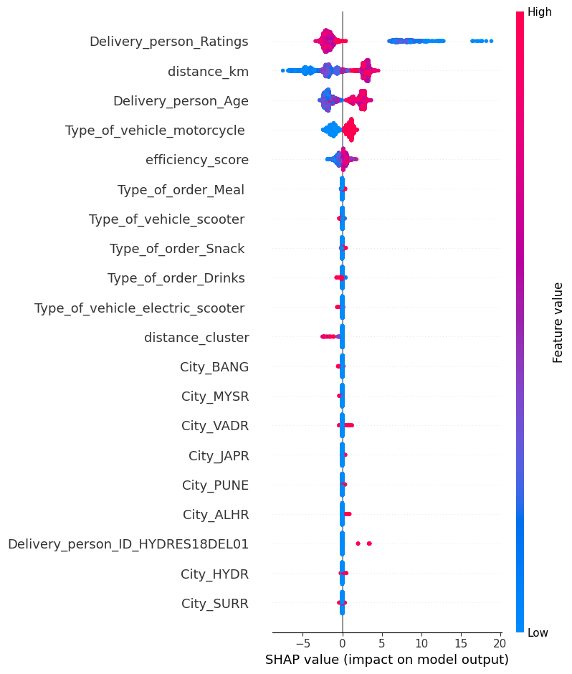



Model Explainability & Trust
Distance Impact
Strongest predictor of delivery time
Driver Quality
Higher ratings reduce estimated time
Interaction Effects
Feature combinations influence efficiency
Our model is not a black box — it is transparent and interpretable.

Slide 8







Beyond Prediction
This is not just a prediction model — it is a logistics decision support system.
ETA Prediction
Delay Risk Estimation
Confidence Interval
Accurate time estimation using ML features
Probability calculation for late delivery
Uncertainty quantification on predictions
Live Route Visualization
Driver Comparison Engine
Real-Time Simulation
Interactive mapping tools for routes
Performance analysis across drivers
What-if scenario testing before dispatch
Intelligence Reports
Automated PDF exports with insights

Slide 9
Real-World Applications & Future Scope
Applications
Food Delivery
E-Commerce Logistics
Platforms requiring accurate time promises
Online retail with delivery commitments
Fleet Optimization
Smart City Infrastructure
Large-scale vehicle allocation systems
Integrated urban delivery networks
Future Enhancements
Real-Time Traffic Integration
Live congestion data from mapping APIs
Weather Data
Precipitation and condition information
GPS Tracking
Live vehicle location monitoring
Dynamic Allocation
AI-based driver assignment after each delivery
SaaS API
Cloud deployment for platform integration

Slide 10




Predictive Logistics for the Future
Intelligent ETA
Risk Awareness
Machine learning-based time prediction
Proactive delay probability assessment
Decision-Driven
Scalable Architecture
Optimization through intelligence
Modular AI component design
We are shifting logistics from reactive operations to predictive intelligence.
Thank you
Questions?

